Slide 1
September 2017
Lauren Lochridge, Working Group Co-Chair
John Wack, NIST Co-Chair
Co-Chair for Auditability and Risk Management: Philp B. Stark
Members of the Voting Methods Working Group(VM-WG) [link]
Voting Methods/Models Update

Slide 2
Voting Methods Working Group (VM-WG)
meeting weekly
34 members, full spectrum of stakeholders
subject or work product production subgroups form as needed
link to twiki [link]
link to new github for draft documents [link]
contact: voting-methods [Old:voting-methods@nist.gov], NEW: voting-methods@list.nist.gov
Voting Methods/Models Update

Slide 3
NIST 1500-X, initial version expected for VVSG 2.0
Set of mathematical models specifying voting methods in precise validated executable logic
Models represent the universe of plain language algorithmic definitions from U.S. elections legislation, guidelines
More precise specification, communication, validation for:
Legislation,
Election Officials (EOs) RFIs and RFPs
Manufacturer’s responses to RFIs & RFPs, documentation
Voting Methods/Models Update

Slide 4
Adopts Cast Vote Record (CVR) CDF [link] for tally/tabulation and Election Results CDF NIST.SP.1500.100 [link]
Data Interoperability & Integrity
Consistent with principles & requirements: NIST Voting Variations [link] and Cybersecurity [link]
Enables Elections Administration systems counting, tabulation, mathematical evaluation, common operations on vote data sets, to be valid to a high degree of confidence, accurate, and cost effective
Can be used to validate that systems conform to statute/legislation/local rules contractually
Voting Methods/Models Update

Slide 5
Audits, evidence-based election procedures, validation approaches and tests for voting system modules
VVSG, legislators, elections officials, may reference precise voting methods definitions in legislation, rules, guidelines
Elections officials and administrators, may unambiguously and precisely specify commonly understood requirements for operations on vote data sets in RFPs
Elections systems manufacturers, software systems providers responses to RFI/RFP
Elections analysts may characterize systems with confidence
Voting Methods/Models Use Cases

Slide 6
For each voting method/module in the specification:
Unique Identifier, Numeric with Text Label
Text description of model element, concise pointers to references
UML model index mapping module to EA Business Process
The written mathematical model in human readable domain specification language (DSL)
Set of test conditions and expected outcomes
Index into an example ballot library illustrating use, including configuration, or testing
Notes briefly describing information, if any, that would be crucial for an adopter of this standard or that may be exceptional, and a pointer to detailed information if necessary
Voting Methods/Models Update

Slide 7
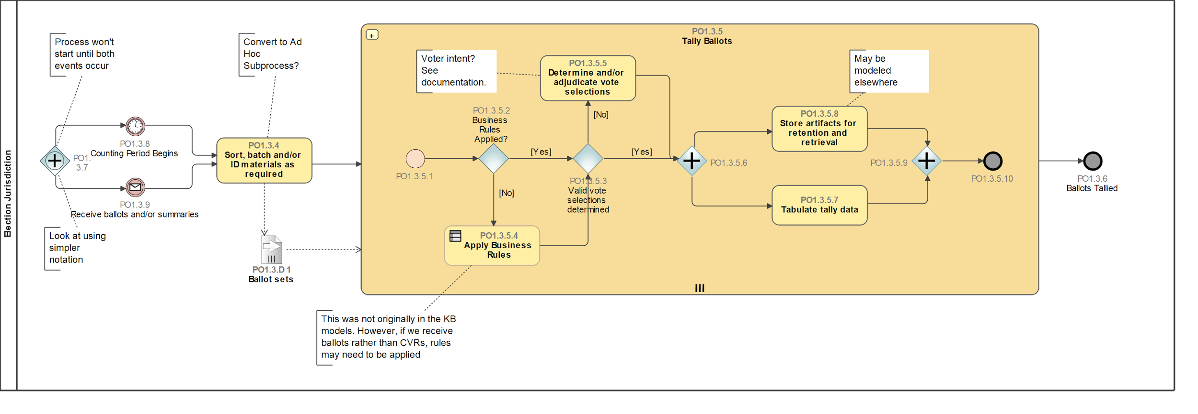
Voting Methods/Models Update
Consistent with Tally & Tabulation in Election Business Process Model[link]

Slide 8
Multi-round voting methods : RCV Draft Model [link]
Overview
This specification section of this standard describes models of the tabulation process for multi-round voting methods. Specifically, this section describes the variety of multi-round voting method where there is a set of candidates in competition to fill one or more seats in a given elected office and a full tabulation of votes may require more than one iteration of tallying to determine the outcome of the election contest.
This section of this standard specification provides a descriptive, rather than prescriptive, model of a tabulation process flow for multi-round voting methods in use in the United States where the voter ranks candidates in order of the voter's preference.
Voting Methods: Work Product

Slide 9
Ranked Choice Voting (RCV)
Benefit to produce the more complex class of voting method first
Rigorous proof of methodology upfront
Provides specification for one of the Voting Variations previously unspecified, aide to Testing and Certification
First Focus: Tabulation process flow for Ranked Choice Voting (RCV)
Type of multi-round voting method in use in the United States where the voter ranks candidates in order of the voter's preference
Handful of current uses in the U.S., in-progress expanded use
E.g. Maine (statewide)), new EMS/existing RCV use SF, CA
High utility for EOs due to complexity of method
Voting Methods: Work Product

Slide 10
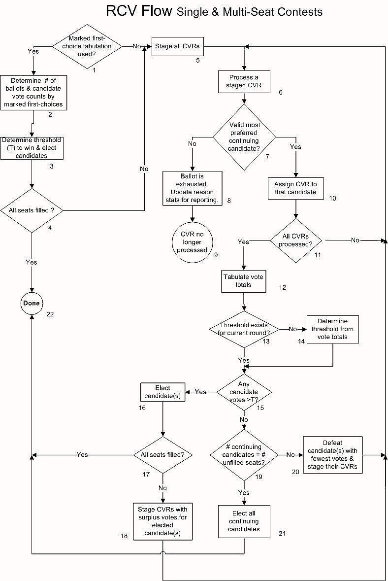
Voting Methods: Work Product
DRAFT RCV tabulation process flow
provides for common U.S. single and multi-seat contests
General and flexible representation of variants of RCV in use in the United States
Scenarios: single or centralized RCV tabulation, aggregation (aka aggregation & rollup)
Contest specifics, specialized local business rules may be configured

Slide 11
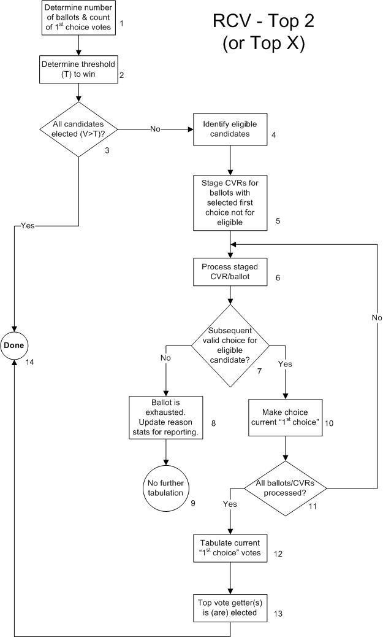
Voting Methods: Work Product
DRAFT Top Two/ Top N Process Flow Example Use:Provides for the variant used by the State of North Carolina and required if the candidate or candidates do not receive sufficient votes to meet the requirement to get elected, attempts to emulate a separate runoff election by making only the top 2 (single seat contest) or top N (multi-seat contest) to be eligible to win.

Slide 12
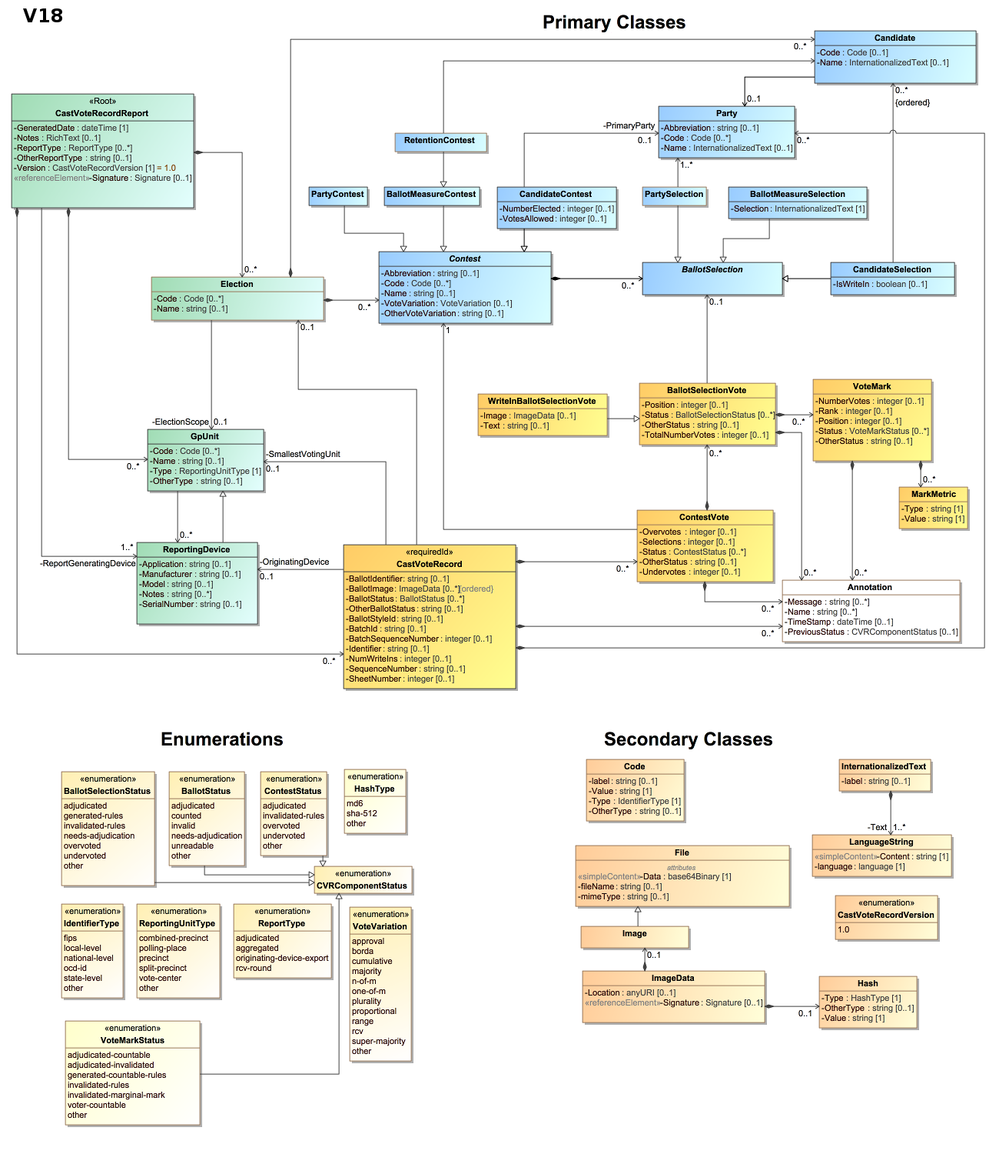
Supports RCV variants that require storing the state of the CVRR or CVR set,
Output CVRR tally/tabulation with corresponding ‘snapshot’ sets of CVRs in sequential order per round
CVR spec. XML & JSON formats support translation into the CVR CDF
Flexible, accommodates internal equipment format of system produces vote selection data sets
Voting Methods: Work Product

Slide 13
Work Product
Near ready to distribute current draft work product for comment
Detailed documentation corresponding to RCV process flow [link]
Detailed legislation sources (plain language algorithm) analysis has been performed [link]
RCV voting method universe objects, rules etc. extracted
Meta Data, Naming Conventions Draft Initiated [link]
Expect to have same artifacts for initial plurality variant First-Past-The-Post, Top Two
Draft NIST 1500-10X update initial models in progress
Initial/Early Adopter outreach soon, in planning
Voting Methods/Models Update

Slide 14
VM-WG Links: http://collaborate.nist.gov/voting/bin/view/Voting/VotingMethodsModels
Github: https://github.com/usnistgov/VotingMethods
Standards & specifications that VM-WG adopts as part of the Voting Methods Standards Specification, as described in this talk (not necessarily the complete list of all adopted specifications and guidelines).
Cast Vote Record CDF GitHub: https://github.com/usnistgov/CastVoteRecords
Election Results Reporting CDF twiki:
http://collaborate.nist.gov/voting/bin/view/Voting/ElectionResultsReporting
Election Business Process Models:
https://pages.nist.gov/ElectionModeling/diagrams.html#Process___18_5_1_11940316_1500467305588_877004_24065
Cybersecurity:
http://collaborate.nist.gov/voting/bin/view/Voting/CyberSecurity
Voting Methods/Models Update

